Slide 1
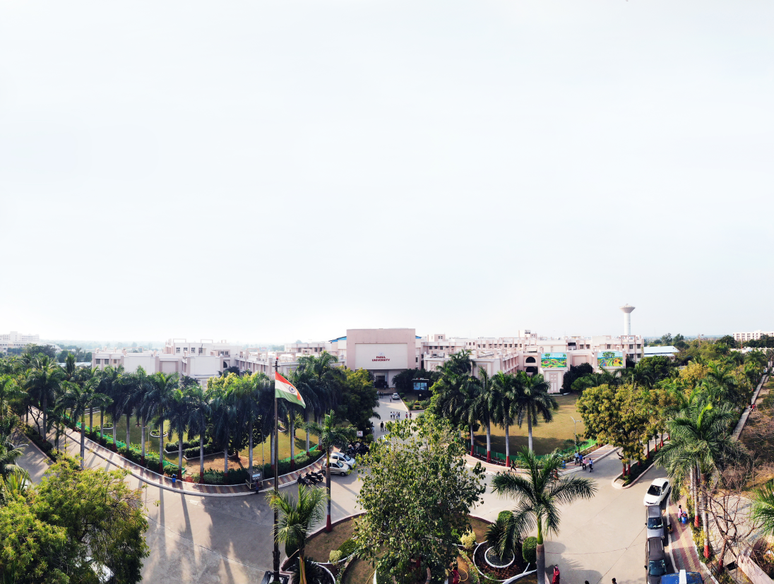


Python Programming Full Stack Development
Milan Anant
Cyber security trainer

Slide 2

UNIT - 1

Slide 3

Python is an open source, interpreted, high-level, general-purpose programming language.
Python is a dynamically typed and garbage-collected language.
Python was Created by Guido van Rossum and first released in 1991.
Python 2.0, released in 2000,
Python 3.0 was released in 2008 and the current version of Python is 3.8.3 (as of June 2020).
The Python 2 language was officially discontinued in 2020open-source

Slide 4

Python has many advantages
Easy to learn
Less code
Syntax is easier to read
Open source
Huge amount of additional open-source libraries

Slide 5
A Python variable is a reserved memory location to store values.
Unlike other programming languages, Python has no command for declaring a variable.
A variable is created the moment you first assign a value to it.
Python uses Dynamic Typing so,
Rules for variable name
Name can not start with digit
Space not allowed
Can not contain special character
Python keywords not allowed
Should be in lower cases.

Slide 6

Example of Python variable: n variable:
1
2
3
4
5
6
7
8
9
10
x = 10
print(x)
print(type(x))
y = 123.456
print(y)
x = “milan"
print(x)
print(type(x))
Output
1
2
3
4
5
10
int
123.456
milan
str

Slide 7
String in python
String is an Ordered Sequence of characters such as “milk”, ‘college’, “cat” etc.
String can be represented as single, double, or triple quotes.
String in Python is immutable.
Square brackets can be used to access elements of the string,

Slide 8
String functions in Python:
Python has lots of built-in methods that you can use on strings, we are going to cover some frequently used methods for strings like
len()
count()
capitalize(), lower(), upper()
istitle(), islower(), isupper()
find(), rfind(), replace()
index(), rindex() etc.
Note: len() is not the method of the string but can be used to get the length of the string
Output : 5 (length of “milan”)
1
2
x = “milan"
print(len(x))

Slide 9
String Methods
count() method will return the number of times a specified value occurs in a string.
title(), lower(), upper() will returns capitalized, lower case and upper case string respectively.
1
2
3
x = “milan"
ca = x.count('a')
print(ca)
Output : 1 (occurrence of ‘a’ in “milan”)
1
2
3
4
5
6
7
x = " milan,Institute, rajkot"
c = x.title()
l = x.lower()
u = x.upper()
print(c)
print(l)
print(u)
Output : Milan, Institute, Rajkot
Output : milan, institute, rajkot
Output : MILAN INSTITUTE, RAJKOT

Slide 10
istitle(), islower(), isupper() will returns True if the given string is capitalized, lower case and upper case respectively.
strip() method will remove whitespaces from both sides of the string and return the string.
rstrip() and lstrip() will remove whitespaces from right and left side respectively.
1
2
3
4
5
6
7
x = ’milan, institute, rajkot'
c = x.istitle()
l = x.islower()
u = x.isupper()
print(c)
print(l)
print(u)
Output : False
Output : True
Output : False
1
2
3
x = ' milan '
f = x.strip()
print(f)
Output : mialn(without space)

Slide 11
find() method will search the string and returns the index at which they find the specified value
rfind() will search the string and returns the last index at which they find the specified value
Output : 6 (occurrence of ‘in’ in x)
1
2
3
x = ’milan institute, rajkot, india'
f = x.find('in')
print(f)
Output : 24 last occurrence of ‘in’ in x)
1
2
3
x = ’milan institute, rajkot,india'
r = x.rfind('in')
print(r)

Slide 12
isalnum() method will return true if all the characters in the string are alphanumeric (i.e either alphabets or numeric).
isalpha() and isnumeric() will return true if all the characters in the string are only alphabets and numeric respectively.
isdecimal() will return true is all the characters in the string are decimal.
Note : isnuberic() and isdigit() are almost same, you suppose to find the difference as Home work assignment for the string methods.
Output : True
1
2
3
x = ’milan2710'
f = x.isalnum()
print(f)
1
2
3
x = '123.5'
r = x.isdecimal()
print(r)
Output : True

Slide 13
We can get the substring in python using string slicing, we can specify start index, end index and steps (colon separated) to slice the string.
x = ’milan anant, rajkot, gujarat, INDIA'
endindex will not be included in the substring
1
2
3
4
5
6
7
8
9
x = milan anant,rajkot, gujarat, INDIA'
subx1 = x[0:5]
subx2 = x[12:17]
subx3 = x[21:]
subx4 = x[::-1]
print(subx1)
print(subx2)
print(subx3)
print(subx4)
Output : ‘milan’
Output :’ ‘r a j k o’
Output : gujarat, INDIA'
Output : ‘AIDNI, tarajug, tokjar, tnana nalim’

Slide 14
str.format() is one of the string formatting methods in Python3, which allows multiple substitutions and value formatting.
This method lets us concatenate elements within a string through positional formatting.
We can specify multiple parameters to the function
1
2
3
4
x = '{} institute, rajkot'
y = x.format(‘milan')
print(y)
Output : milan institute, rajkot
1
2
3
x = '{} institute, {}'
y = x.format(‘milan','rajkot')
print(y)
Output : milan institute, rajkot

Slide 15
We can specify the order of parameters in the string
We can also specify alias within the string to specify the order
1
2
3
x = '{1} institute, {0}'
y = x.format(‘milan','rajkot')
print(y)
Output : rajkot institute, milan
1
2
x = '{collegename} institute, {cityname}'
print(x.format(collegename=‘milan',cityname='rajkot'))
Output : milan institute, rajkot

Slide 16
List
List is a mutable ordered sequence of objects, duplicate values are allowed inside list.
List will be represented by square brackets [ ].
We can use slicing similar to string in order to get the sub list from the list.
Output : institute (List index starts with 0)
Output : 3 (length of the List)
1
2
3
4
5
6
my_list = [‘milan', 'institute', ’rakot']
print(my_list[1])
print(len(my_list))
my_list[2] = "rajkot"
print(my_list)
print(my_list[-1])
Output : [‘milan', 'institute', 'rajkot']
Note : spelling of rajkot is updated
Output : rajkot (-1 represent last element)
Output : ['institute', 'rajkot']
Note : end index not included
1
2
my_list = ['darshan', 'institute', 'rajkot','gujarat','INDIA']
print(my_list[1:3])

Slide 17
List Methods
append() method will add element at the end of the list.
insert() method will add element at the specified index in the list
extend() method will add one data structure (List or any) to current List
1
2
3
my_list = [‘milan', 'institute', 'rajkot']
my_list.append('gujarat')
print(my_list)
Output : [‘milan', 'institute', 'rajkot', 'gujarat']
1
2
3
4
my_list = [‘milan', 'institute', 'rajkot']
my_list.insert(2,'of')
my_list.insert(3,'engineering')
print(my_list)
Output : [‘milan', 'institute', 'of', 'engineering', 'rajkot']
1
2
3
4
my_list1 = [‘milan', 'institute']
my_list2 = ['rajkot','gujarat']
my_list1.extend(my_list2)
print(my_list1)
Output : [‘milan', 'institute', ‘rajkot', ‘gujarat']

Slide 18

pop() method will remove the last element from the list and return it.
remove() method will remove first occurrence of specified element
clear() method will remove all the elements from the List
1
2
3
my_list = [‘milan', 'institute','rajkot']
temp = my_list.pop()
print(my_list)
Output : [‘milan', 'institute‘]
1
2
3
my_list = [‘milan', 'institute', 'darshan','rajkot']
my_list.remove(‘milan')
print(my_list)
Output : ['institute', 'darshan', 'rajkot']
my_list = [‘milan', 'institute', ’milan','rajkot']
my_list.clear()
print(my_list)
1
2
3
Output : []

Slide 19
count() method will return the number of occurrence of the specified element.
reverse() method will reverse the elements of the List
sort() method will sort the elements in the List
1
2
3
my_list = [‘milan', 'institute', ’milan','rajkot']
c = my_list.count(‘milan')
print(c)
Output : 2
1
2
3
my_list = [‘milan', 'institute','rajkot']
my_list.reverse()
print(my_list)
Output : ['rajkot', ‘institute’,’milan']
1
2
3
my_list = [‘milan', 'college','of','enginnering','rajkot']
my_list.sort()
print(my_list)
Output : ['college', 'enginnering’, ‘milan’, 'of', 'rajkot']

Slide 20
Tuple
Tuple is a immutable ordered sequence of objects, duplicate values are allowed inside list.
Tuple will be represented by round brackets ( ).
Tuple is similar to List but List is mutable whereas Tuple is immutable.
Output : (‘’milan', 'institute', 'of', 'engineering', 'of', 'rajkot')
Output : 3 (index of ‘engineering’)
1
2
3
4
5
my_tuple = (‘milan','institute','of','engineering','of','rajkot')
print(my_tuple)
print(my_tuple.index('engineering'))
print(my_tuple.count('of'))
print(my_tuple[-1])
Output : 2
Output : rajkot

Slide 21
Dictionary
Dictionary is a unordered collection of key value pairs.
Dictionary will be represented by curly brackets { }.
Dictionary is mutable.
my_dict = { 'key1':'value1', 'key2':'value2' }
Key value is seperated by :
Key value pairs is seperated by ,
1
2
3
my_dict = {'college’:”milan", 'city':"rajkot",'type':"engineering"}
print(my_dict['college'])
print(my_dict.get('city'))
values can be accessed using key inside square brackets as well as using get() method
Output : milan
rajkot

Slide 22
Dictionary methods
keys() method will return list of all the keys associated with the Dictionary.
values() method will return list of all the values associated with the Dictionary.
items() method will return list of tuples for each key value pair associated with the Dictionary.
1
2
my_dict = {‘college’:”milan", 'city':"rajkot",'type':"engineering"}
print(my_dict.keys())
Output : ['college', 'city', 'type']
Output : [‘milan', 'rajkot', 'engineering']
1
2
my_dict = {'college’:”milan", 'city':"rajkot",'type':"engineering"}
print(my_dict.values())
Output : [('college', ‘milan'), ('city', 'rajkot'), ('type', 'engineering')]
1
2
my_dict = {'college’:”milan", 'city':"rajkot",'type':"engineering"}
print(my_dict.items())

Slide 23
Set
Set is a unordered collection of unique objects.
Set will be represented by curly brackets { }.
Set has many in-built methods such as add(), clear(), copy(), pop(), remove() etc.. which are similar to methods we have previously seen.
Only difference between Set and List is that Set will have only unique elements and List can have duplicate elements.
Output : {1, 2, 3, 5, 9}
1
2
my_set = {1,1,1,2,2,5,3,9}
print(my_set)

Slide 24
Operators in python
We can segregate python operators in the following groups
Arithmetic operators
Assignment operators
Comparison operators
Logical operators
Identity operators
Membership operators
Bitwise operators

Slide 25
Arithmetic Operators
Note : consider A = 10 and B = 3
Operator | Description | Example | Output
+ | Addition | A + B | 13
- | Subtraction | A - B | 7
/ | Division | A / B | 3.3333333333333335
* | Multiplication | A * B | 30
% | Modulus return the remainder | A % B | 1
// | Floor division returns the quotient | A // B | 3
** | Exponentiation | A ** B | 10 * 10 * 10 = 1000

Slide 26
Logical Operators
Note : consider A = 10 and B = 3
Operator | Description | Example | Output
and | Returns True if both statements are true | A > 5 and B < 5 | True
or | Returns True if one of the statements is true | A > 5 or B > 5 | True
not | Negate the result, returns True if the result is False | not ( A > 5 ) | False

Slide 27
Identity & Member Operators
Identity Operator
Note : consider A = [1,2], B = [1,2] and C=A
Member Operator
Note : consider A = 2 and B = [1,2,3]
Operator | Description | Example | Output
is | Returns True if both variables are the same object | A is B A is C | FALSE TRUE
is not | Returns True if both variables are different object | A is not B | TRUE
Operator | Description | Example | Output
in | Returns True if a sequence with the specified value is present in the object | A in B | TRUE
not in | Returns True if a sequence with the specified value is not present in the object | A not in B | FALSE

Slide 28

If statement
if statement is written using the if keyword followed by condition and colon(:) .
1
2
if some_condition :
# Code to execute when condition is true
if statement ends with :
1
2
3
4
x = 10
if x > 5 :
print("X is greater than 5")
Output
X is greater than 5

Slide 29
If else statement
1
2
3
4
if some_condition :
# Code to execute when condition is true
else :
# Code to execute when condition is false
1
2
3
4
5
6
x = 3
if x > 5 :
print("X is greater than 5")
else :
print("X is less than 5")
Output
1
X is less than 5

Slide 30
If, elif and else statement
1
2
3
4
5
6
if some_condition_1 :
# Code to execute when condition 1 is true
elif some_condition_2 :
# Code to execute when condition 2 is true
else :
# Code to execute when both conditions are false
1
2
3
4
5
6
7
8
x = 10
if x > 12 :
print("X is greater than 12")
elif x > 5 :
print("X is greater than 5")
else :
print("X is less than 5")
Output
1
X is greater than 5

Slide 31
For loop in python
Many objects in python are iterable, meaning we can iterate over every element in the object.
such as every elements from the List, every characters from the string etc..
We can use for loop to execute block of code for each element of iterable object.
For loop ends with :
Syntax
1
2
for temp_item in iterable_object :
# Code to execute for each object in iterable
Indentation (tab/whitespace) at the beginning
Output :
1
2
3
4
fordemo2.py
Output :
2
4
6
8
fordemo1.py
1
2
3
4
my_list = [1,2,3,4,5,6,7,8,9]
for list_item in my_list :
if list_item % 2 == 0 :
print(list_item)
1
2
3
my_list = [1, 2, 3, 4]
for list_item in my_list :
print(list_item)

Slide 32
While loop
While loop will continue to execute block of code until some condition remains True.
For example,
while felling hungry, keep eating
while have internet pack available, keep watching videos
Syntax
while loop ends with :
Output :
X is greater than 3
1
2
while some_condition :
# Code to execute in loop
Indentation (tab/whitespace) at the beginning
withelse.py
1
2
3
4
5
6
x = 5
while x < 3 :
print(x)
x += 1 # x++ is valid in python
else :
print("X is greater than 3")
whiledemo.py
Output :
0
1
2
1
2
3
4
x = 0
while x < 3 :
print(x)
x += 1 # x++ is valid in python

Slide 33
break, continue & pass keywords
break : Breaks out of the current closest enclosing loop.
continue : Goes to the top of the current closest enclosing loop.
Pass : Does nothing at all, will be used as a placeholder in conditions where you don’t want to write anything.
breakdemo.py
Output :
0
1
1
2
3
4
5
for temp in range(5) :
if temp == 2 :
break
print(temp)
continuedemo.py
Output :
0
1
3
4
1
2
3
4
5
for temp in range(5) :
if temp == 2 :
continue
print(temp)
passdemo.py
Output : (nothing)
1
2
for temp in range(5) :
pass

